Slide 1
AIRLINE RESERVATION SYSTEM
Ayush Agrawal, Rajat Agrawal, Pavan Bykampadi

Slide 2
About
The Airline Reservation System is an interface for users and airlines to interact and connect to each other.
It makes it convenient for both airlines and consumers to discover each other, providing a single platform for users to book flights across airlines.
It can also help an airline to manage its bookings and flights effeciently

Slide 3
Functionality
Users can search for their required flights, getting complete information about them
They can further view their bookings, and cancel if required
Airlines can add new, delete old and view all information about current flights.

Slide 4
Functionality: Airline
. As an admin:
An admin of The Airline Reservation System will be able to add and delete flights.
To add a flight, several details like the name of the flight, the date and time of departure and arrival, the source and destination airport and the cost per seat.
For deleting a particular flight, a table displaying the flights are shown and the sl.no of the flight to be deleted must be inputted.

Slide 5
Concepts Used:
Pre-Processor Directives
Structures
Functions
Arrays
Loops

Slide 6
Functions Defined In The Program
preset_vals()
password()
drawline()
header()
table_header()
table_line()
display_flights()
add_flight()
del_flight()
status()
pay()
confirmation()
search()
userf()
admin()
front_page()
main()

Slide 7
Header Files Used
iostream
stdio.h
stdlib.h
iomanip
conio.h
process.h
string.h

Slide 8
Structures Defined
Date
Flight
User

Slide 9
Flow Chart
User menu and functions
User
START
Enter log in credentials
User or Admin
Log out?
STOP
Admin
Admin menu and functions

Slide 10
User:
Input menu option:
Book
View Bookings
Exit
Logout?
Login
Yes
STOP
No
Menu option:
2
1
Input Search Criterion
Display Bookings
Display results
Exit/
Cancel
Exit
Cancel
Confirm, Book and Pay
Cancel Booking

Slide 11
Admin:
Input menu option:
Add flight
Delete flight
Display all flights
Exit
Login
Logout?
Yes
STOP
No
Menu option:
1
2
Input Flight Details
3
Display All flights
Display All flights
Create Flight
Input flight to be deleted
Delete Flight

Slide 12
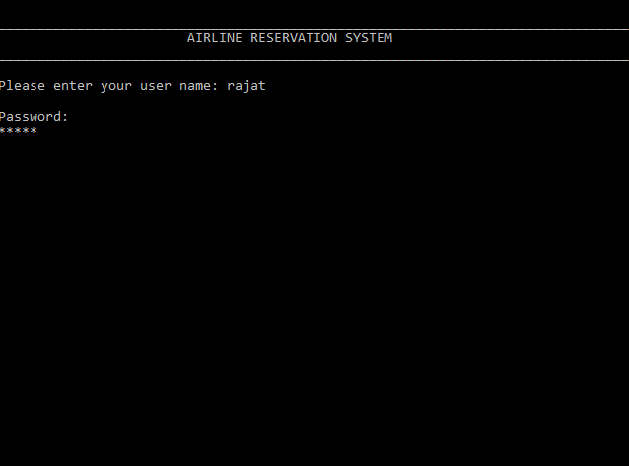
Screenshots

Slide 13
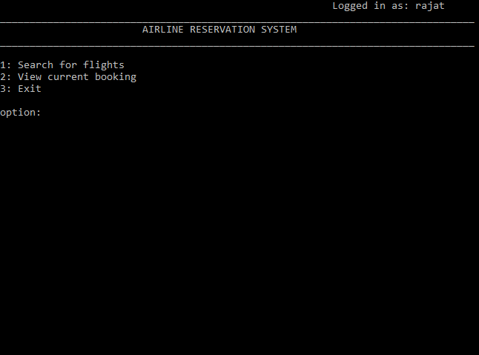

Slide 14
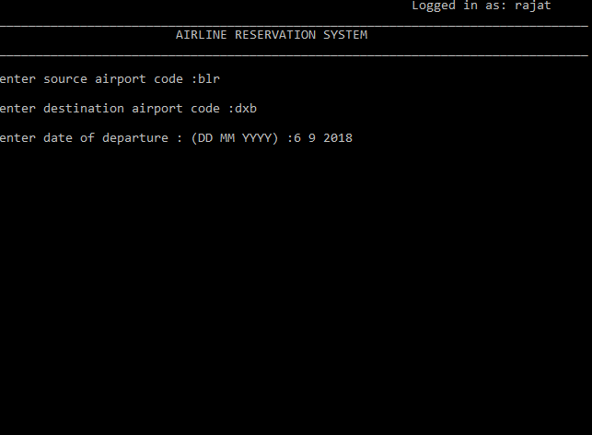

Slide 15
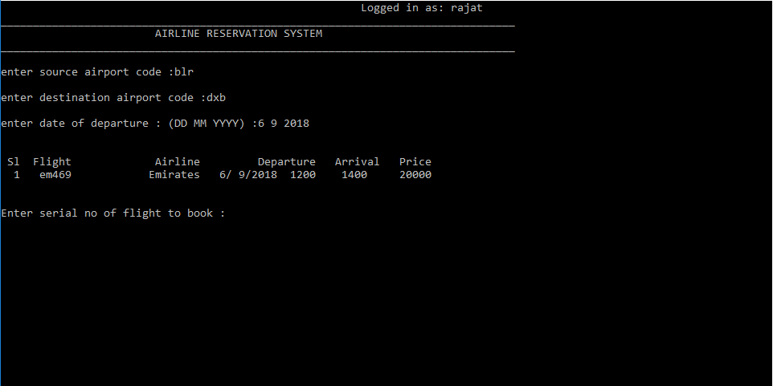

Slide 16
